Slide 1
Cerebellum Ataxia
Dr. Gaurav C. Mhaske
Dept. Of Neurophysiotherapy
MGM Institute Of Physiotherapy
Chh. Sambhajinagar

Slide 2
Objectives
By the end of the session the learner should be able to:
Discuss common challenges to function
Discuss the benefits of exercise
Identify current literature

Slide 3
At the end of the lecture the student should be able to
Identify external features of cerebellum
Enumerate neurons, fibers, nuclei and layers of cerebellum
Identify connections of cerebellum
Identify clinical application

Slide 4
Introduction
Cerebellar dysfunction may result in significant functional difficulties with upper and lower limb movement, oculo-motor control, balance and walking

Slide 5
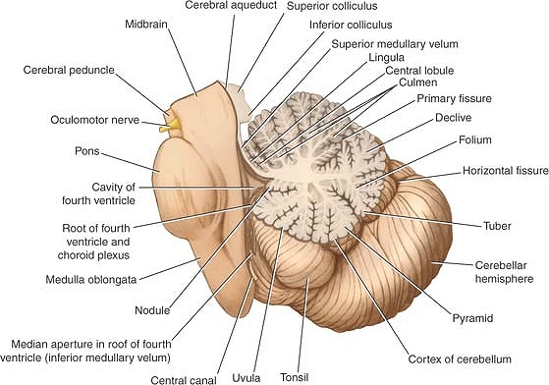
Cerebellum
Situated in the posterior cranial fossa and is covered superiorly by the tentorium cerebelli.
It is the largest part of the hindbrain (10% of total weight) and lies posterior to the fourth ventricle, the pons, and the medulla oblongata.
It consists of two cerebellar hemispheres joined by a narrow median vermis.

Slide 6
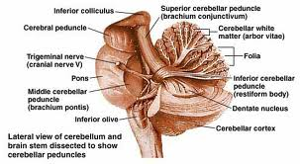
Cerebellum
Three symmetrical bundles of nerve fibers called the superior, middle, and inferior cerebellar peduncles.
Superior peduncle enters mid brain
Middle peduncule consist of transverse fibres of pons
Inferior peduncle connect with medulla

Slide 7
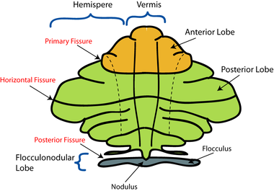
Cerebellum
The cerebellum is divided into three main lobes: the anterior lobe, the middle lobe, and the flocculonodular lobe.
The anterior lobe may be seen on the superior surface.
It is separated from the middle lobe by a wide V-shaped fissure called the primary fissure.
The middle lobe (sometimes called the posterior lobe), which is the largest part of the cerebellum, is situated between the primary and uvulonodular fissures.
The flocculonodular lobe is situated posterior to the uvulonodular fissure.

Slide 8
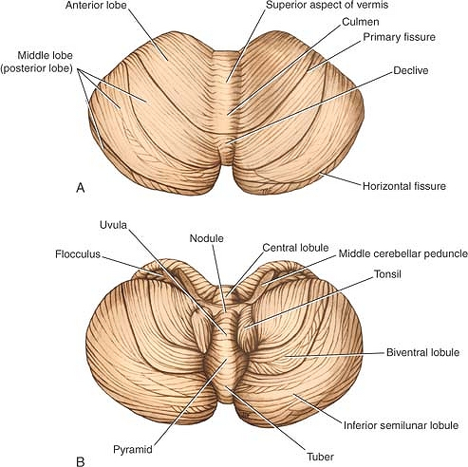
Cerebellum
Sup part of vermis
Lingula
Culmen
Declive
Folium
Inferior part of vermis
Tuber
Pyramid
Uvula
Nodule

Slide 9
Vermis

Slide 10
Cerebellum connections
Functionally cerebellum divided in corpus cerebelli and flocculonodular lobe
Corpus cerebelli:
afferent from spinal cord and trigeminal nuclei
Inputs from pontine nucleus
Flocculonodular lobe
Connections with vestibular nucleus

Slide 11
Cerebellum connections
Anterior lobe and pyramid mainly receive spinal and trigeminal afferents
Corticopontine connections are relayed to posterior lobe, tuber, vermis and uvula

Slide 12
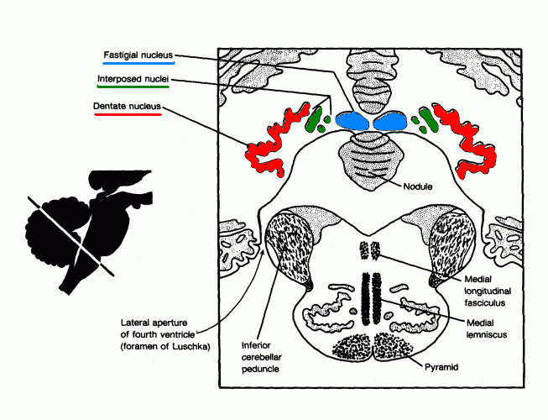
Cerebellar nuclei
Histologically made up of three layers
Embedded in white matter are four paired nuclei
Dentate is largest
Main connection is cerebropontocerebellar
Efferent fibres pass to contralateral red nucleus, thalamus, and cerebral cortex.

Slide 13
Cerebellar peduncles
Superior cerebellar peduncle
Efferent of dentate nucleus
Afferent: anterior spinocerebellar tract, Tectocerebellar from mid brain.
Middle cerebellar peduncle
Afferent fibres from pontine nucleus.
Inferior cerebellar peduncle
Efferent: cerebellovestibular tarct
Afferent: vestibulocerebellar tract, post spinocerebellar, cuneocerebellar, oivocerebellar

Slide 14
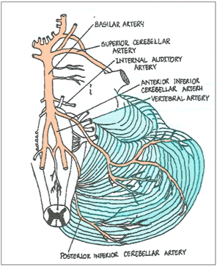
Blood supply
Posterior inferior cerebellar artery
Anterior inferior cerebellar artery
Branch of basilar artery
Superior cerebellar artery

Slide 15
Clinical application
Lesion of floccolonodular lobe leads to disequilibrium.
Lesion of cerebropontine connections leads to hypotonia, diminished muscle jerk, intention tremor, clumsy movements
Isolated lesions of the vermis are produced in children by medulloblastomas in the roof of the fourth ventricle

Slide 16
Clinical application
Anterior lobe lesions leads to ataxia
Dysdiadochokinesia: inability to perform alternating movements regularly and rapidly
Dysarthria occurs in cerebellar disease because of ataxia of the muscles of the larynx

Slide 17
What is the role of the Cerebellum?
Center for Balance, Coordination, and Learning
Controls all Motor behavior
Limb Movements
Trunk Movements
Eye Movements
Speech

Slide 18
Ataxia Symptoms
Impaired Coordination
Difficulty with reaching for objects or writing
Decreased balance
Impairments with postural adjustments and control of balance
Difficulty Walking
Varied step placement due to trouble with leg coordination
Trouble controlling eye movements
Slurring of speech
NO WEAKNESS
Feel “weak” due to impaired motor control

Slide 19
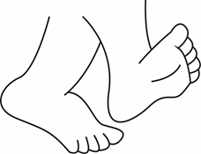
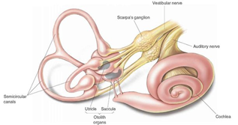
Balance Systems
Vision
Somatosensory
Vestibular

Slide 20
What about Walking?
Decreased Coordination in Legs and Trunk
+
Impaired Balance
=
Variability of steps
Increased Falls
Fatigue

Slide 21
What is a better predictor of improved quality of walking?
A: Leg Placement (coordination)
B: Balance
Answer: Balance (Morton and Bastian 2003)
Notes:
Amy Bastian from KKI did a study in 2003 where they took 20 controls, 20 cerebellar patients. They measured a dynamic balance weight shifting task then also measured a leg placement task with visually guided stepping. After measuring those they looked at fast gait speed. They found that overall gait function was predicted by the severity of imbalance and not leg incoordination
So Balance dysfunction predicts cerebellar gait ataxia not just incoordination.

Slide 22
Aetiology of Cerebellar Ataxia

Slide 23
Motor signs and symptoms and tests in cerebellar disease

Slide 24
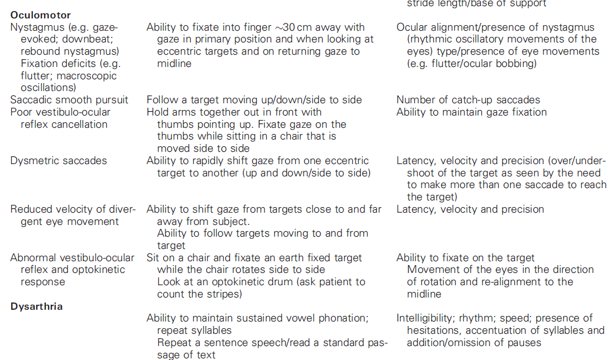

Slide 25
Ataxia
Ataxia is a lack of muscle coordination that may affect a person’s speech, eye movements, and ability to swallow, walk, and pick up objects, among other voluntary movements.
Many conditions and other factors can cause ataxia, including multiple sclerosis (MS), head trauma, excessive alcohol intake, a stroke, cerebral palsy, genetics, and tumors.
Ataxia may also result from certain immunological disorders and infections.
There are many types of ataxia. In this article, we discuss some of the more common types, their causes, and the available treatments.

Slide 26
Ataxia is a symptom that can result from a range of conditions. It affects a person’s coordination, speech, and balance. It can also make it hard to swallow and walk.
Some people are born with ataxia due to genetic factors. Others develop it over time. For some people, it can result from another condition, such as a stroke, MS, a brain tumor, or a head injury, or even from excessive alcohol consumption.
It can start suddenly, get worse over time, or stabilize. This depends partly on the cause.

Slide 27
Types
The following are some of the most common types of ataxia:
Cerebellar ataxia
This type of ataxia results from a dysfunction of the cerebellum, a region of the brain that plays a role in assimilating sensory perception, coordination, and motor control.
Cerebellar ataxia can cause neurological symptoms such as:
jerking or shaking of the body or limbs when trying to move
decreased muscle tone
lack of coordination between organs, muscles, limbs, or joints
difficulty controlling distance, power, and speed of an arm, hand, leg, or eye movement
difficulty accurately estimating how much time has passed
inability to perform rapid, alternating movements

Slide 28
Sensory Ataxia
This is a type of ataxia that develops due to a loss of proprioception.
Proprioception is a person’s sense of the relative position of neighboring parts of their body.
It is a sense that indicates whether the body is moving with appropriate effort and gives feedback on the position of body parts relative to each other.
Sensory ataxia typically results in:

Slide 29
Sensory Ataxia
an unsteady, stomping gait, with the heel striking hard as it touches the ground with each step
postural instability that becomes worse in poorly lit environments
If a person stands with their eyes closed and feet together, the instability will worsen. This is because a loss of proprioception increases their reliance on visual data.
They may find it hard to perform smoothly coordinated voluntary movements with the limbs, trunk, pharynx, larynx, and eyes.

Slide 30
Vestibular ataxia
This type of ataxia affects the vestibular system, which plays a role in hearing.
It can result from nerve damage in the ear.
In acute (sudden) unilateral cases, this can lead to:
vertigo
nausea
vomiting
In slow-onset chronic bilateral cases, a person may only experience unsteadiness.
There may also be a combination of causes, such as vestibulocerebellar ataxia.

Slide 31
Ataxia telangiectasia
Its appear in childhood. Apart from appearing to be “a bit wobbly,” a child may also experience:
spider veins in the whites of the eyes, the ears, or elsewhere on the face frequent infections
Another genetic, progressive type of ataxia, called Friedreich’s ataxia, often appears between the ages of 10 and 15 years.

Slide 32
Symptoms include
a sideward curvature of the spine, or scoliosis
weakened heart muscle
high arching feet
Conditions that may occur alongside Friedreich’s ataxia include diabetes and heart problems, and there may be complications relating to the spine, feet, heart, muscles, vision, and hearing.
A person with this type of ataxia will need supportive treatment throughout their life.
If ataxia results from an injury or illness, such as a stroke, symptoms often improve over time and may eventually go away completely.

Slide 33
American College of Sports Medicine Exercise Recommendations

Slide 34
ACSM: Aerobic Exercise
Frequency: >5 days a week of moderate exercise, or >3 days a week of vigorous exercise
Intensity: Moderate and/or Vigorous Intensity
Duration: 30-60 minutes a day, total 150 minutes a week of purposeful moderate exercise
Mode: Regular, purposeful exercise that involves major muscle groups and is continuous and rhythmic in nature
Exercise may be performed in one continuous session per day or in multiple sessions of more than 10 minutes to accumulate the desired duration and volume of exercise per day

Slide 35
ACSM: Resistance Exercise
Frequency: Each major muscle group should be trained 2-3 days a week
Intensity: 60-70% of the 1 repetition max
Repetitions: 8-12 repetitions
Sets: 2-4 sets to improve strength and power
Rest: Rest >48 hours between sessions for any single muscle group
Decrease intensity and increase repetitions to improve muscular endurance

Slide 36
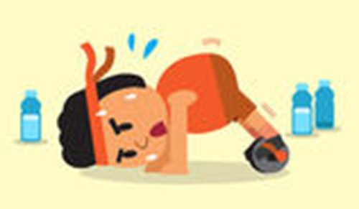
ACSM: Flexibility Exercise
Frequency: >2-3 days a week
Intensity: Stretch to the point of feeling tightness or slight discomfort
Duration: Hold a static stretch for 30-60 seconds
Mode: Series of flexibility exercises for each of the major muscle-tendon units
Flexibility exercise is most effective when the muscle is warmed through light to moderate aerobic activity or passively through external methods such as moist heat packs.

Slide 37
ACSM: Neuromotor Exercise
Frequency: >2-3 days a week
Intensity: Unknown
Duration: >20-30 minutes per day
Mode: balance, agility, coordination, gait
Methods for optimal progression are not known

Slide 38
Can Exercise slow Disease Progression?
Exercise may help regain functional performance of one or more years of the disease progression (miyai, ilg)
SARA scores may worsen 0.4 to 2.2 points per year depending on type of ataxia (Jacobi 2011)
Intensive Coordination Therapy studies have shown SARA Scores improve up to 5.2 points = Gaining 2 or More YEARS of disease progression (Miyai, Ilg 2009)

Slide 39
What are your goals?
Infrequent Faller
Improve Dynamic balance
Decrease falls risk
Prevent need for an assistive device
Playing sports etc.
Frequent Faller
Improve task specific skills
Transfer training
Improve Static Balance
Decrease Falls
Set and establish goals with help of a Physical Therapist

Slide 40
Examples of goals:
Infrequent Faller
Frequent Faller
Talk to family while walking
Walk and carry something without spilling it
Negotiate a curb safely
Be able to play catch with my son
Be able to transfer from the bed to a chair without help
Stand in the kitchen and talk to family without having to hold onto the counter
Use the regular chair at a restaurant instead of my wheelchair

Slide 41
Benefits of Balance Training
Improved Quality of Walking
Decreased Variability of steps
Decreased Variability of sway
Improved Walking Speed
Reduces Risk of Falls
Improves Motor Planning
Ilg 2009, 2015; Bastian and Keller 2014

Slide 42
Intensive Coordinative Training Improves Motor Performance in Degenerative Cerebellar Disease Ilg et al. 2009
Results
Decline of average of 5.2 points on SARA
Increased Gait Speed
Less Variability of step placement
All equal less risk for falls!
Patients
16 patients
10 with Cerebellar Ataxia
6 with Sensory Ataxia
Intervention
4 weeks of Intensive therapy with a therapist
3x a week for 1 hour sessions

Slide 43
What did they do for Exercise?
Static Balance Exercises
Dynamic Balance Exercises
Standing with varied feet position
Sitting on varied surfaces
Kneeling with arm movement
Stepping while standing
Climbing stairs
Side stepping
Walking on uneven ground

Slide 44
Exercises to prevent Falls
Stepping in multiple directions
External perturbations by the therapist while standing or moving
Quadruped (on all 4s) and practice of floor transfers
Squatting and standing back up

Slide 45
6 week home exercise study for people with cerebellar damage (Keller, Bastian 2014)
Patients
14 patients with cerebellar ataxia
Assessments
Walking speed
Walking balance tests
Intervention
Home Physical Therapy
Notes:
Key Take Home Point: How much effort the patients were putting in Not about more and easy it is about quality and challenge level

Slide 46
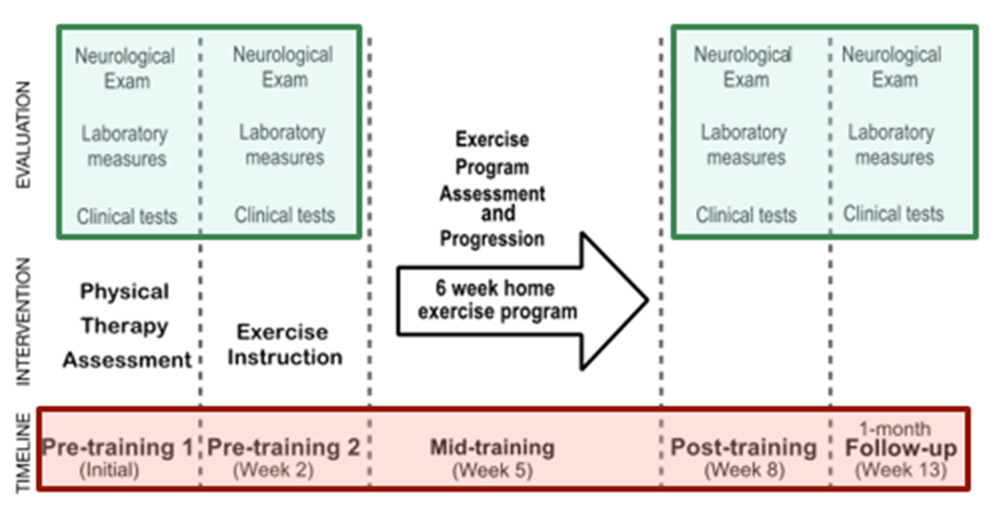

Slide 47
Sitting Balance Exercises
Movement on Varied Support Surfaces
Adapted from Jennifer Keller

Slide 48
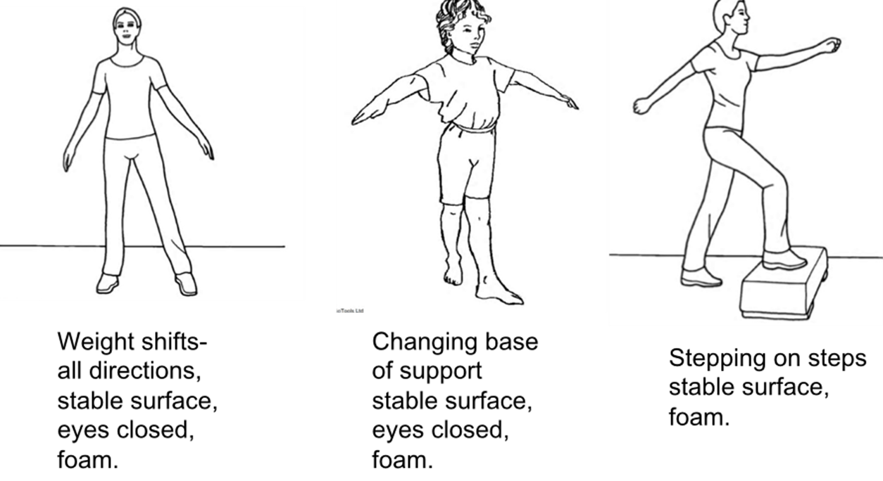
Standing Balance Exercises
Adapted from Jennifer Keller

Slide 49
Thank You

